Slide 1
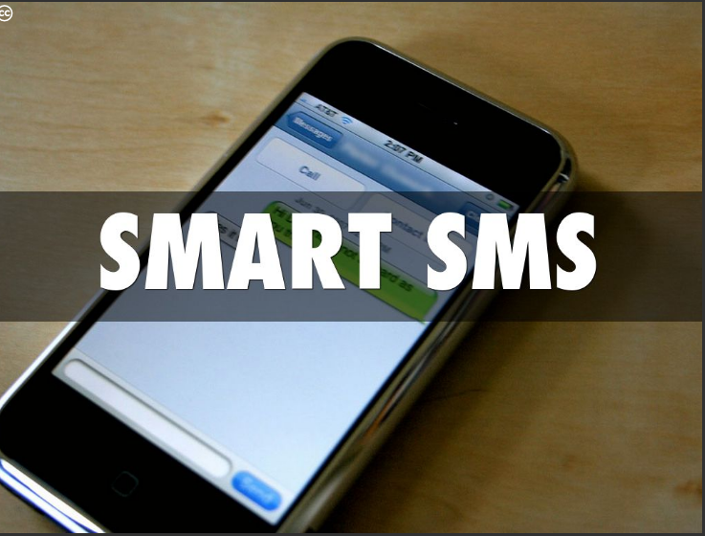

Slide 2
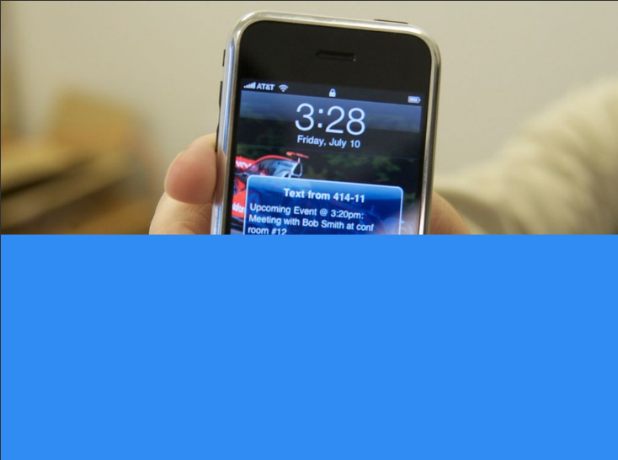
Smart SMS in several simple steps allows you to never forget to greet your friends, for birthday or for any other occasion. Smart SMS is inspired by the latest trends in UX design and everything within the app happens with ease. It is has an SMS scheduler and an auto-responder that responds to your SMS.

Slide 3
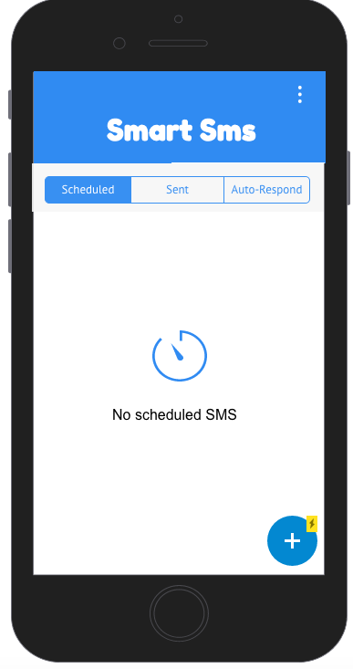
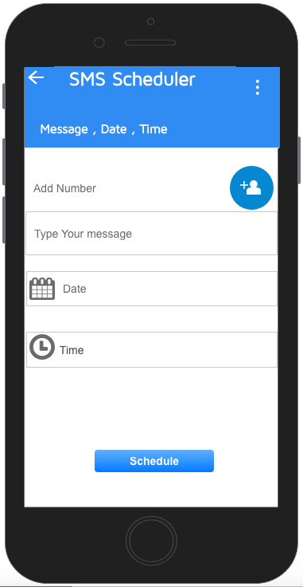

Slide 4
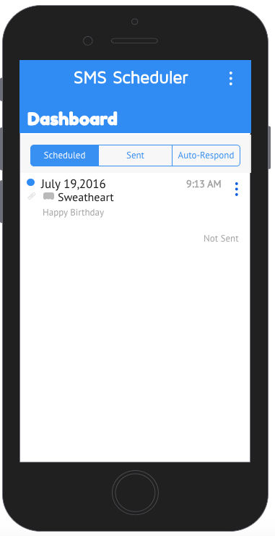

Send
Delete

